Slide 1


ANC Helmets
Team: ANC Team
Members: Animesh, Nikita and Charley

Slide 2
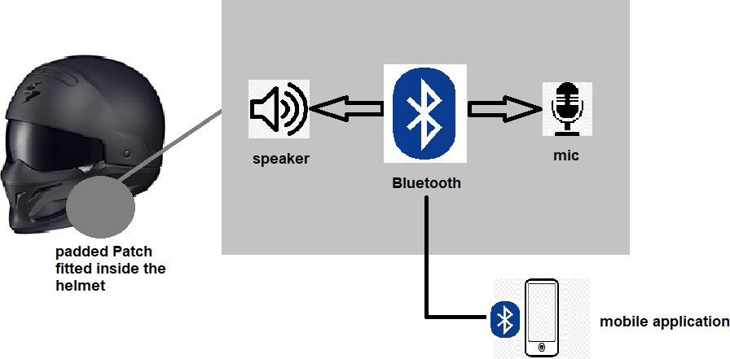
Architecture

Slide 3
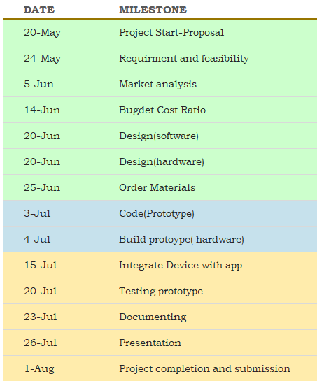
Milestones

Slide 4
Timeline

Slide 5

Short demo-Prototype

Slide 6

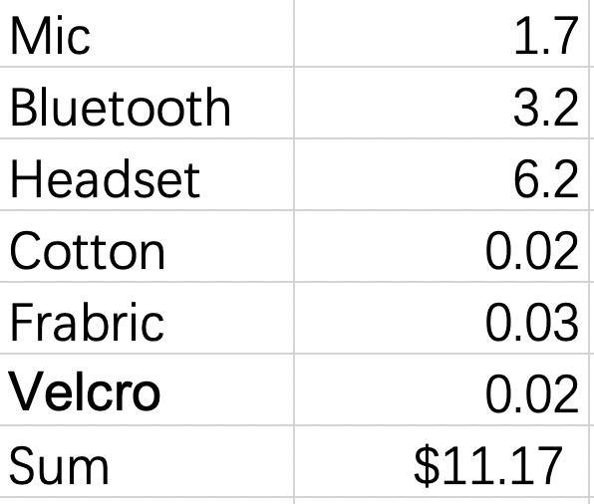
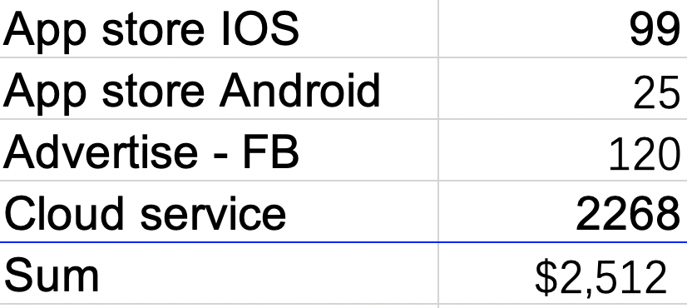
Operating costs
Benefit – Cost Ratio
Manufacturing Costs
Operating Costs

Slide 7
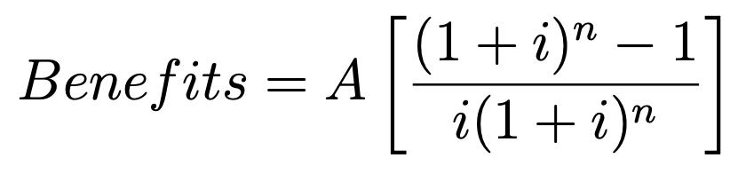
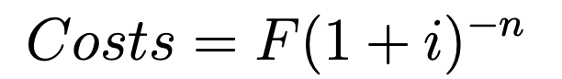
Benefit – Cost Ratio
6903
6903
6903
6903
6903
The proposed selling price of each product is $ 30.
To break-even in the first year, we need to make 134 products in total.
4
1
2
3
5
8097
To have a good amount of profit, let us assume we could make 500(annually) products.
Expenses for manufacturing 500(annually) products=$8097
If we sell it for $30 per product=$15000
Net Profit ( annually)= 15000-8097= $6903
Assume, interest rate to be 5% for 5 years,
Benefits= 6903*(4.329)=$29883
Costs=$8097
Benefit-Cost ratio=3.69>1, there it’s a good plan so far

Slide 8
Future Perspective
There are two paths:
1. We are not able to breakeven – In that case, we need to find a different plan
2. We get enough profit and expand our business, we need to make more products( more than 500)- In this case , we need to add manufacturing cost and get our production done in mass. That would require loans from bank and it would look roughly like as given below
6903
6903
6903
6903
16318
16318
Benefit-cost ratio=4.5 (approx.)
1
2
3
4
5
6
8097
5000

Slide 9
Thank you

